Slide 1

Department of Artificial Intelligence
Cancer Detection Using Deep Learning Approaches
Notes:
1

Slide 2

Cancer Detection Using Deep Learning Approaches
Presented By
Mostafa Tarek 94071
Mohamed Ezz 94303
Abd El-Rahman Ahmed 94218
Amr Samir 90369
Nour Ehab 90330
Under Supervision
Prof. Rania Elgohary
DR. Mohamed Badawi
T.A. Shaimaa Bahaa
T.A. Shereen Youssef

Slide 3
Outline
Introduction
Motivation
Problem Definition
Related Works
Methodology
Proposed System
System Architecture
Software Tools
Platforms
User Interface
Results
Conclusion
Future work
References

Slide 4


Introduction
Skin cancer and brain tumors are global health concerns, requiring understanding and prevention. AI offers promise in detection, treatment, and prevention. Skin cancer includes types like BCC, SCC, and melanoma [1], often diagnosed late. Brain tumors, less common but serious, can affect essential brain functions. AI helps in early detection of skin cancer through photo analysis and in brain tumor detection through medical imaging.
Detection
Segmentation
Classification
Automation

Slide 5
Motivation
1. Patients: Individuals concerned about skin cancer or brain tumors can use our platform to analyze their images and receive preliminary insights, providing valuable information for discussion with healthcare professionals.
2. Healthcare Institutions: Hospitals, clinics, and healthcare facilities can integrate our technology into their systems to enhance diagnostic capabilities, streamline workflows, and improve patient outcomes.
3. Researchers: Scientists and researchers in the field of medical imaging and artificial intelligence can utilize our platform for data analysis, algorithm validation, and development of new methodologies.
Healthcare Institutions
Research Community
Patients

Slide 6

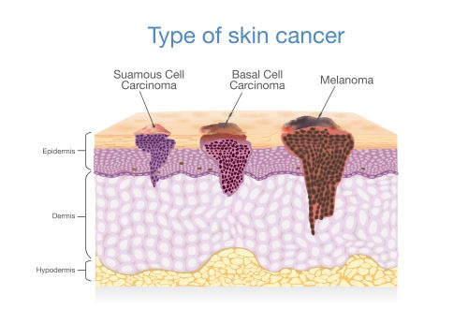
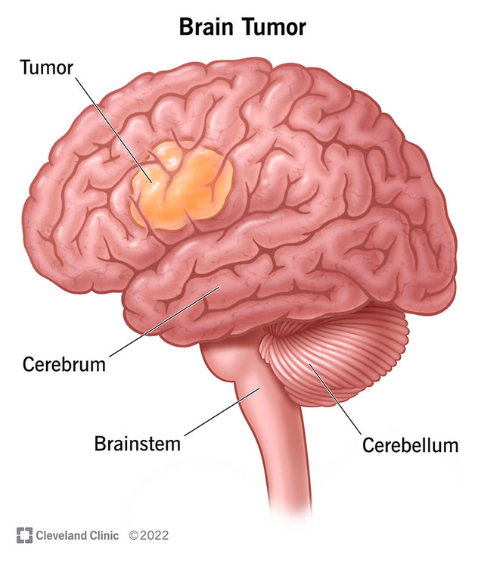
Problem Definition
Skin cancer affects approximately 5.4 million cases globally, with an incidence rate of 3.1% of all cancer cases worldwide. Detecting skin cancer accurately is crucial due to its prevalence and potential for early intervention to improve patient outcomes.
Brain tumors constitute around 2.3% of all cancer diagnoses globally, affecting approximately 700,000 people each year. Accurate delineation of tumor boundaries is essential for treatment planning, as it can help surgeons navigate delicate brain tissue and minimize damage during surgical procedures, ultimately improving patient prognosis.

Slide 7
Skin Cancer Related Works
Deep Learning-Based Skin Lesion Segmentation and Classification of Melanoma Using Support Vector Machine (SVM)
SSD-KD: A Self-Supervised Diverse Knowledge Distillation Method for Lightweight Skin Lesion Classification Using Dermoscopic Images
2023
2019
2022
Light-Dermo: A Lightweight Pretrained Convolution Neural Network for the Diagnosis of Multiclass Skin LesionsLight-Dermo: A Lightweight Pretrained Convolution Neural Network for the Diagnosis of Multiclass Skin Lesions
Comparative Study on Different Deep Learning Models for Skin Lesion Classification Using Transfer Learning Approach
Multi-Class Skin Lesion Classification Using a Lightweight Dynamic Kernel Deep-Learning-Based Convolutional Neural Network
2021
2022
Improved Skin Lesion Recognition by a Self-Supervised Curricular Deep Learning Approach
Multiclass Skin Lesion Localization and Classification Using Deep Learning-Based Features Fusion and Selection Framework for Smart Healthcare
2021
2023

Slide 8
Brain Tumor Related Works
An EffcientNet-encoder U-Net Joint Residual Refinement Module with Tversky–Kahneman Baroni–Urbani–Buser loss for biomedical image Segmentation
CFNet: A medical image segmentation method using the multi-view attention mechanism and adaptive fusion strategy,
2024
2023
2022
A deep model towards accurate boundary location and strong generalization for medical image segmentation
A novel medical image segmentation approach by using multi-branch segmentation network based on local and global information synchronous learning
Evaluation of magnetic resonance image segmentation in brain low-grade gliomas using support vector machine and convolutional neural network
2023
2021
Brain tumor segmentation and grading of lower-grade glioma using deep learning in MRI images
2021
Improved U‑Net architecture with VGG‑16 for brain tumor segmentation
2020

Slide 9
Main Objectives
To advance current knowledge and optimize model performance for the detection of skin and brain tumor through a comprehensive exploration of modeling approaches. This includes leveraging transfer learning from pre-trained models and investigating shot learning techniques, such as few-shot learning and one-shot learning.
BUILDING A STRONG DETECTION SYSTEM
CREATE A PLATFORM:
Website
Streamlit APP
Desktop APP

Slide 10
Skin
Cancer

Slide 11
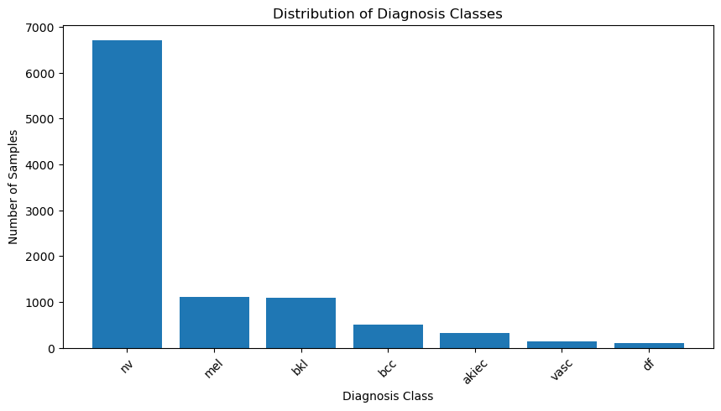
Methodology
Dataset:
PH2 for Segmentation
HAM10000 for Classification
Unbalanced Dataset Challenge

Slide 12
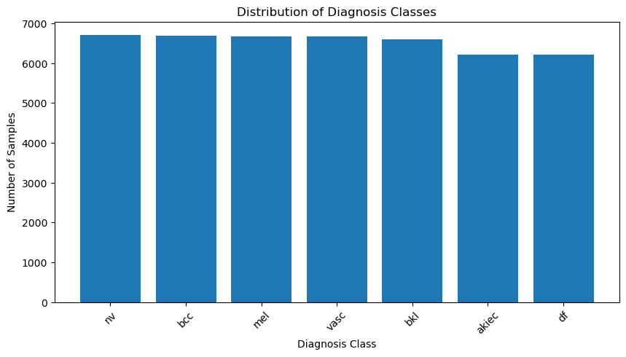
Methodology (Cont.)
Dataset: HAM1000
Duplicating images for augmentation purposes
The duplication process didn't introduce new augmentation transformations.
NV class preserved
Augmentation transformations (rotation, shifting, flipping) applied only to training process

Slide 13
Proposed System for Skin Cancer
User Input
Data Preprocessing
Model Localization
User Output
Model Classification

Slide 14
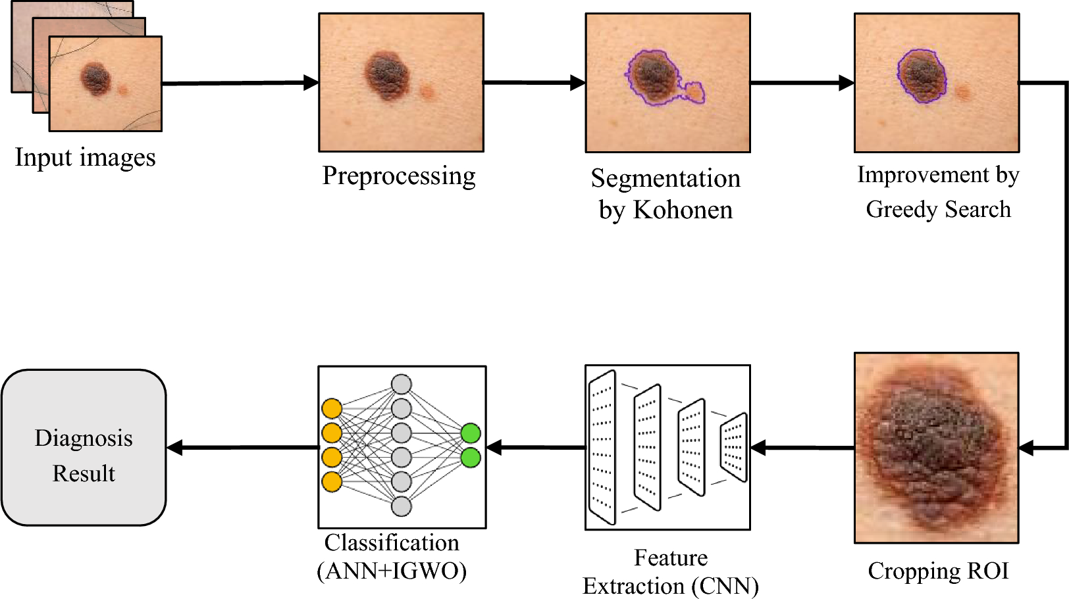
Proposed System for Skin Cancer (Cont.)

Slide 15
Brain
Tumor

Slide 16
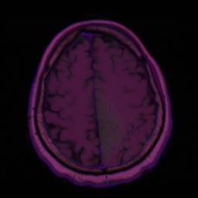
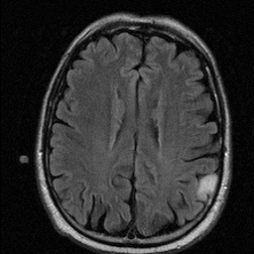
Methodology
Dataset:
LGG Brain Segmentation Dataset for Segmentation
Tiff format
TIFFs are a handy way to store high-quality images to avoid lossy file formats

Slide 17
Proposed System for Brain Tumor
User Input
Data Preprocessing
Model Segmentation
User Output

Slide 18
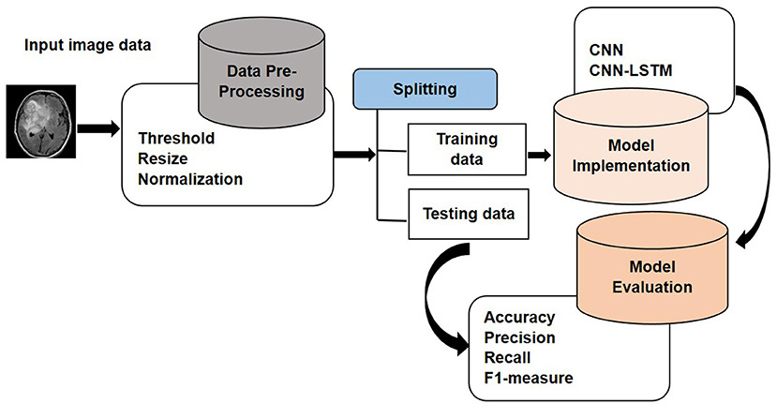
Proposed System for Brain Tumor (Cont.)

Slide 19
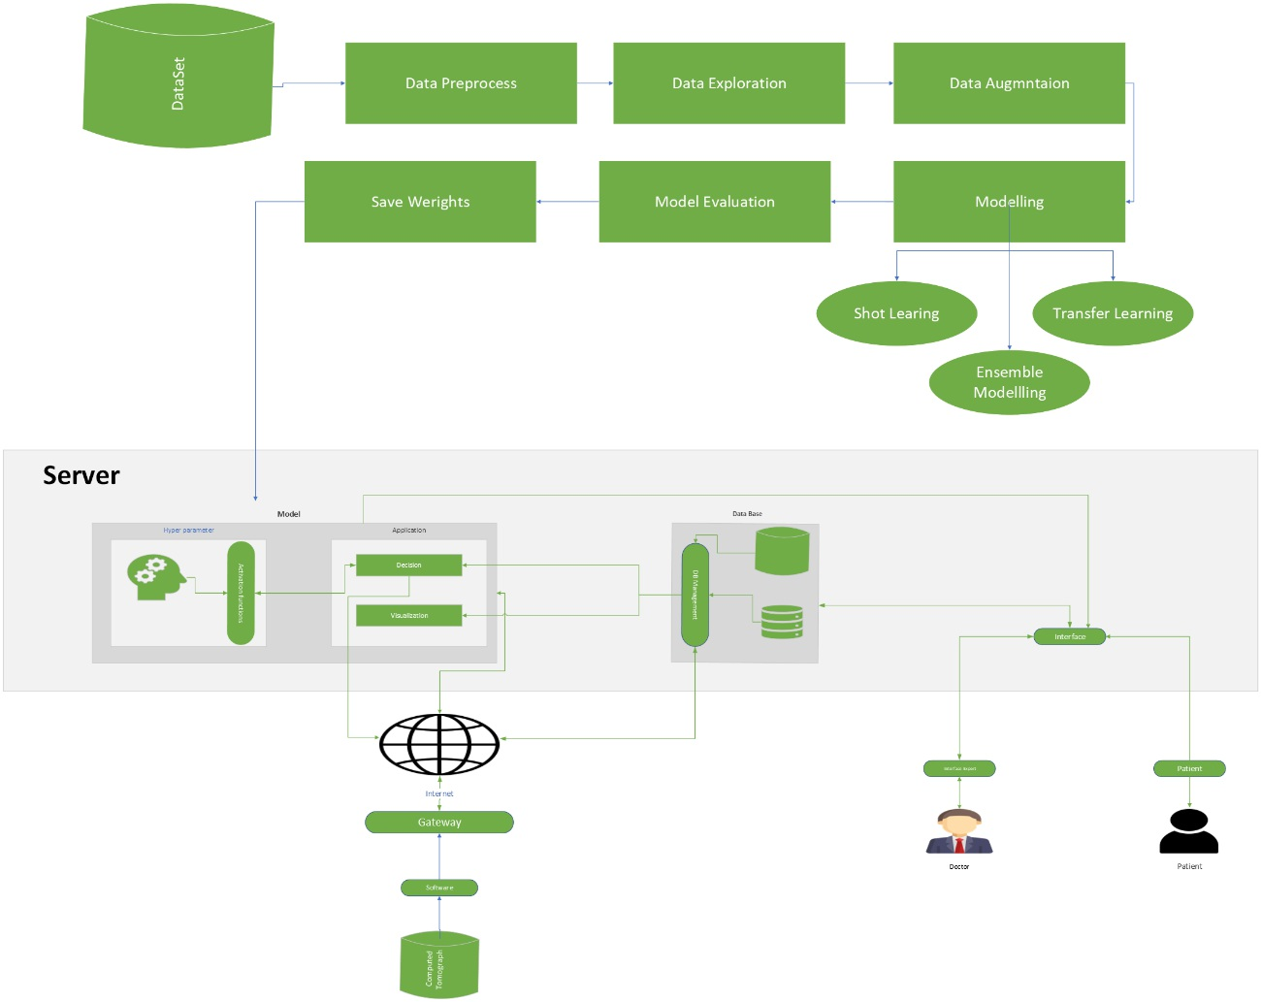
System Architecture

Slide 20
Brain Tumor
Segmentation

Slide 21
Methodologies and Techniques for segmentation
DATA PREPROCESSING
DATA AUGMENTATION
01
02
01
02
set the image width and height to 256
Data Augmentation
Rotation
Shiftting
03
04
03
04
normalize the data to be from 1 and 0
Zooming
Flibbing
Make Batch size to 32

Slide 22
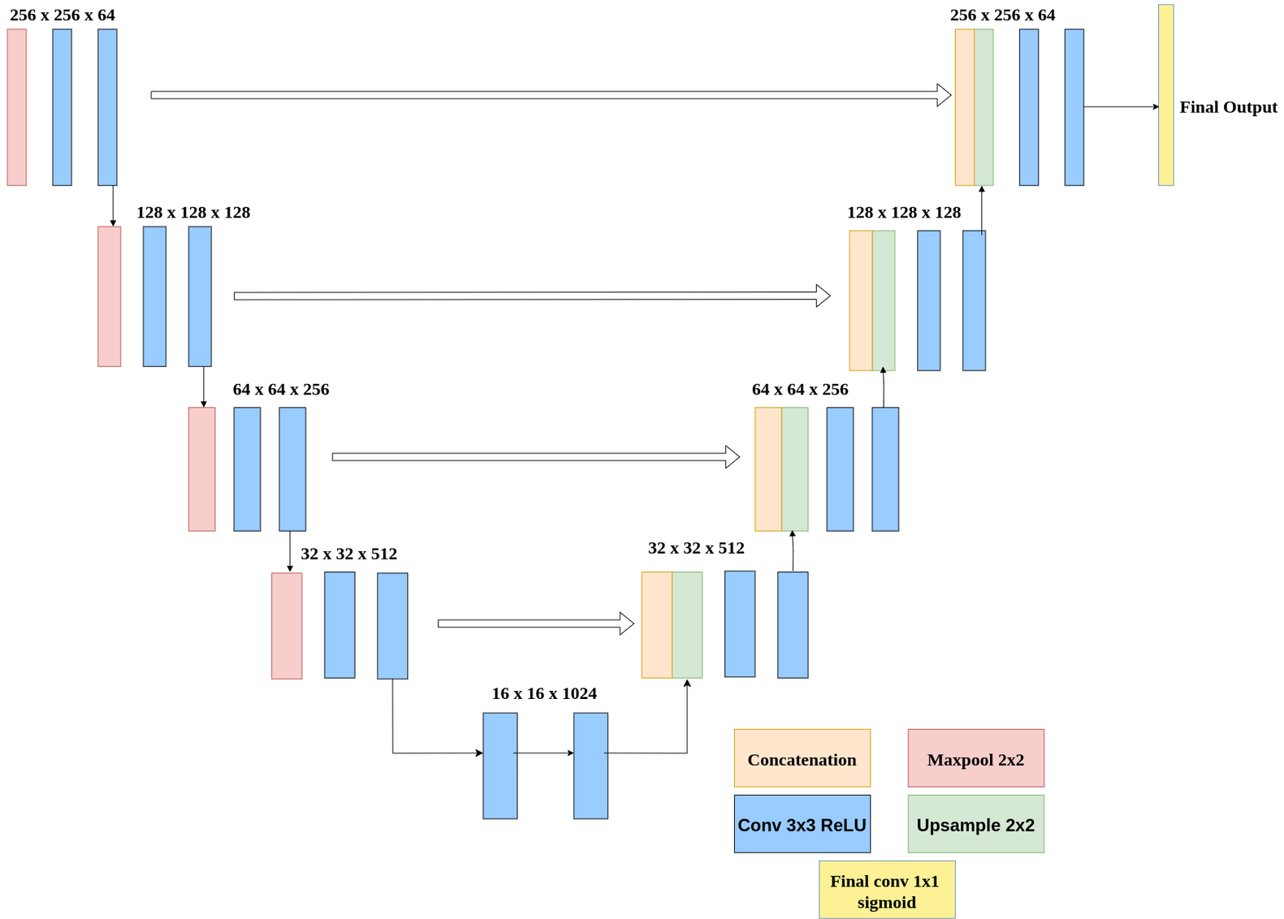
Brain Segmentation Model Architecture

Slide 23
Training and Testing Metrics for Our Models
Training Metrics | Training Metrics | Training Metrics | Training Metrics
Model Name | Accuracy | Dice Coefficient | iou
U-NET | 0.9986 | 0.9276 | 0.8675
Attention ResUNet | 0.9985 | 0.9182 | 0.8501
inceptionv3 | 0.9976 | 0.886 | 0.7999
resnet50 | 0.9981 | 0.9014 | 0.8248
resnext50 | 0.998 | 0.9014 | 0.8245
Testing Metrics | Testing Metrics | Testing Metrics | Testing Metrics
Model Name | Accuracy | Dice Coefficient | iou
U-NET | 0.9984 | 0.9127 | 0.8411
Attention ResUNet | 0.9982 | 0.9022 | 0.8252
inceptionv3 | 0.9975 | 0.8673 | 0.7698
resnet50 | 0.9977 | 0.8801 | 0.7898
resnext50 | 0.9976 | 0.8721 | 0.7783

Slide 24
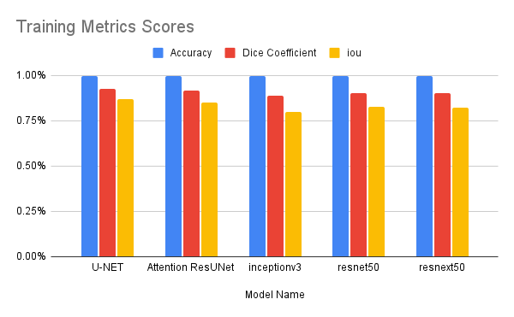
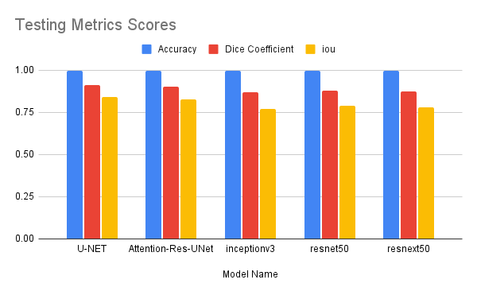
Training and Testing Graphs for Our Models

Slide 25
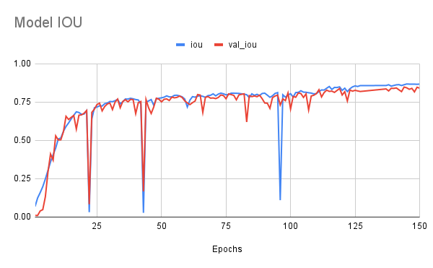
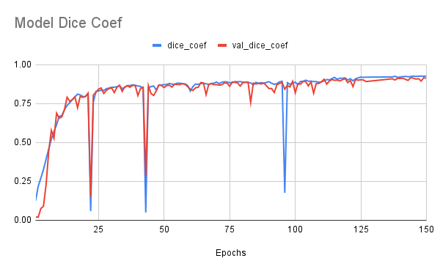
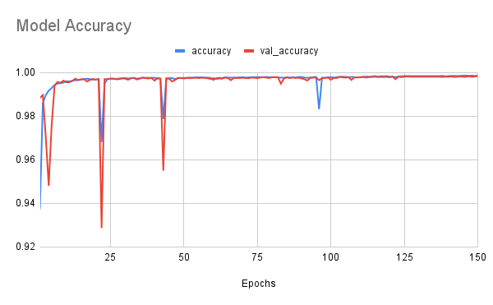
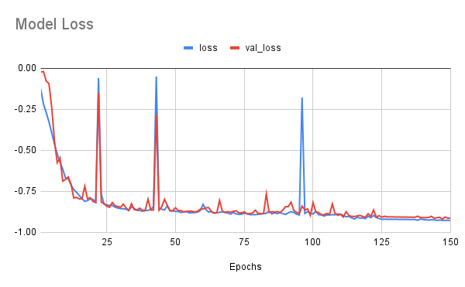
History of performance over the epochs

Slide 26
Training Metrics for Us and Other Papers
Model Name | accuracy | dsc | iou
MN Trinh et al. | - | 91.51 | 84.58
B Zhan et al. | - | 85.7 | 75.81
MA Naser & MJ Deen | 89 | - | -
F Özyurt et al. | 95.62 | - | -
Q Yang et al. | 93.7 | - | -
S Ghosh et al. | - | 91.81 | -
B Wang et al. | - | 82 | 69.5
S Jin et al. | - | 75.17 | 60.23
The Proposed Method | 99.86 | 92.76 | 86.75

Slide 27
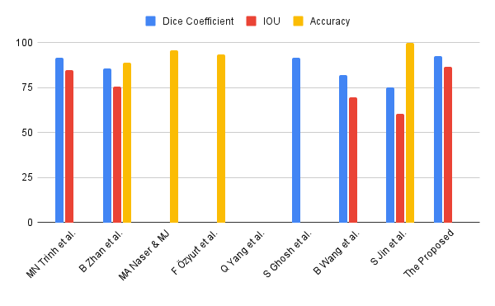
Training Graph for Us and Other Papers

Slide 28
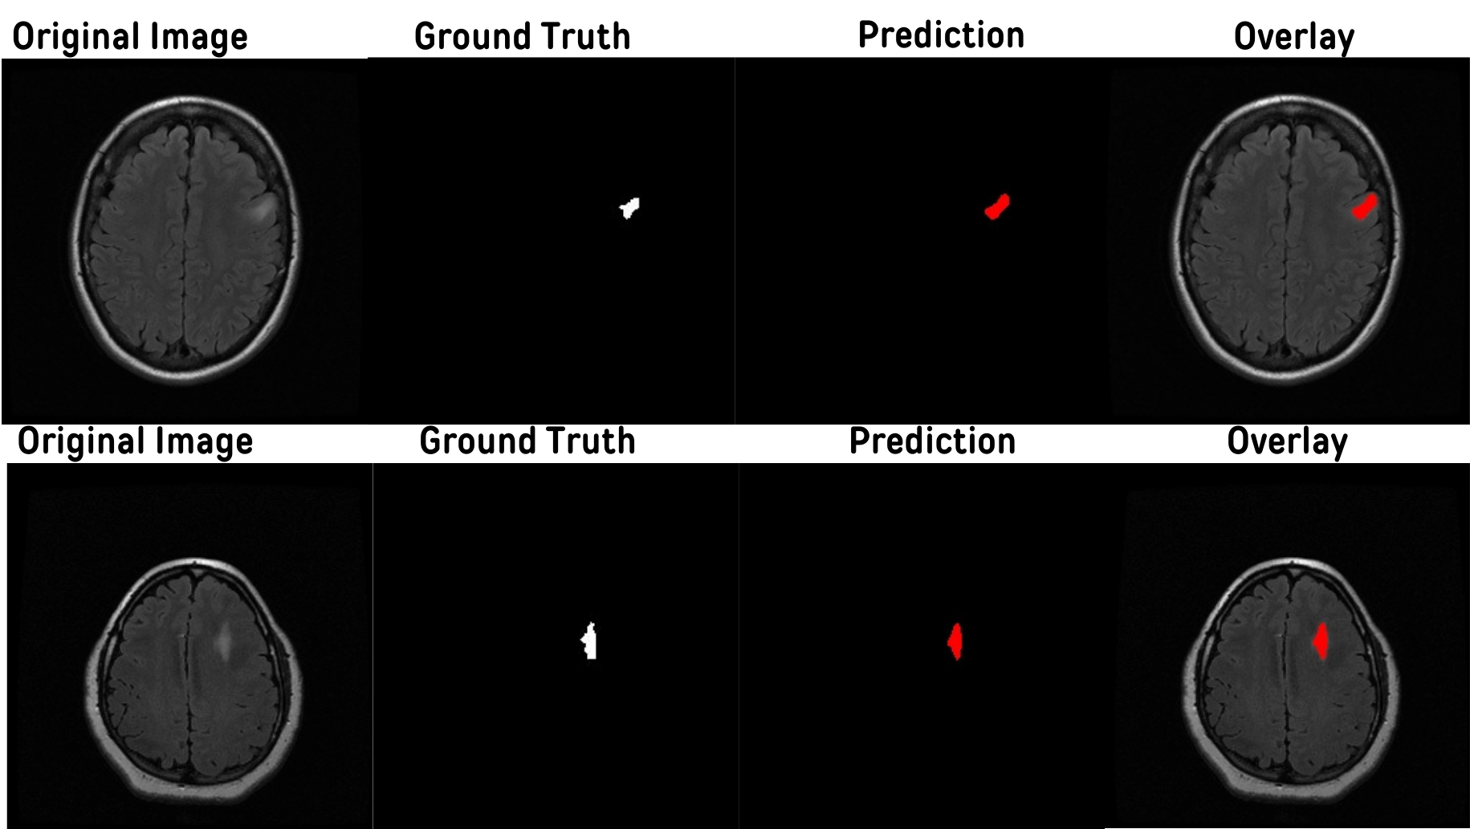
Sample of our model prediction

Slide 29
Skin
Segmentation

Slide 30
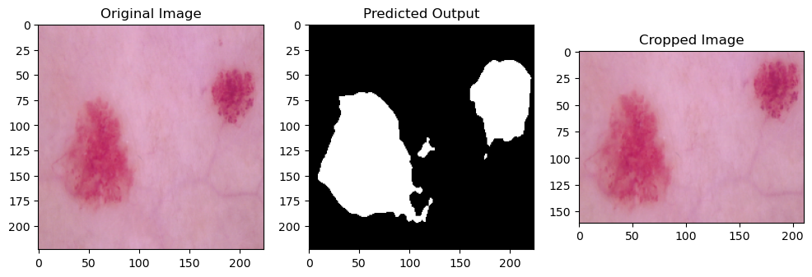
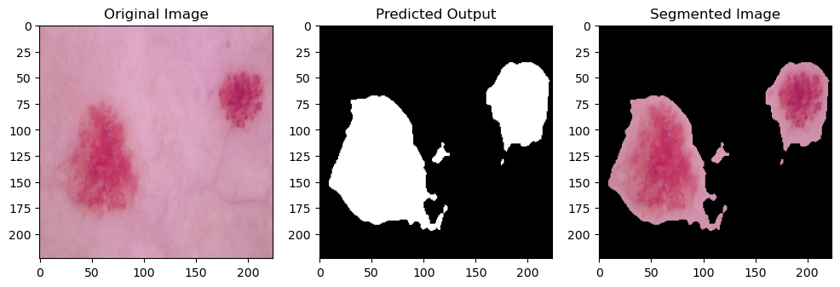
Why need segmentation?
Noise Reduction
Simplify Analysis
Accurate Features

Slide 31
Methodologies and Techniques for Segmentation
DATA PREPROCESSING
DATA AUGMENTATION
01
02
01
set the image width and height to 224
Data Augmentation
Rotation
03
02
Make Batch size to 16
Flipping

Slide 32
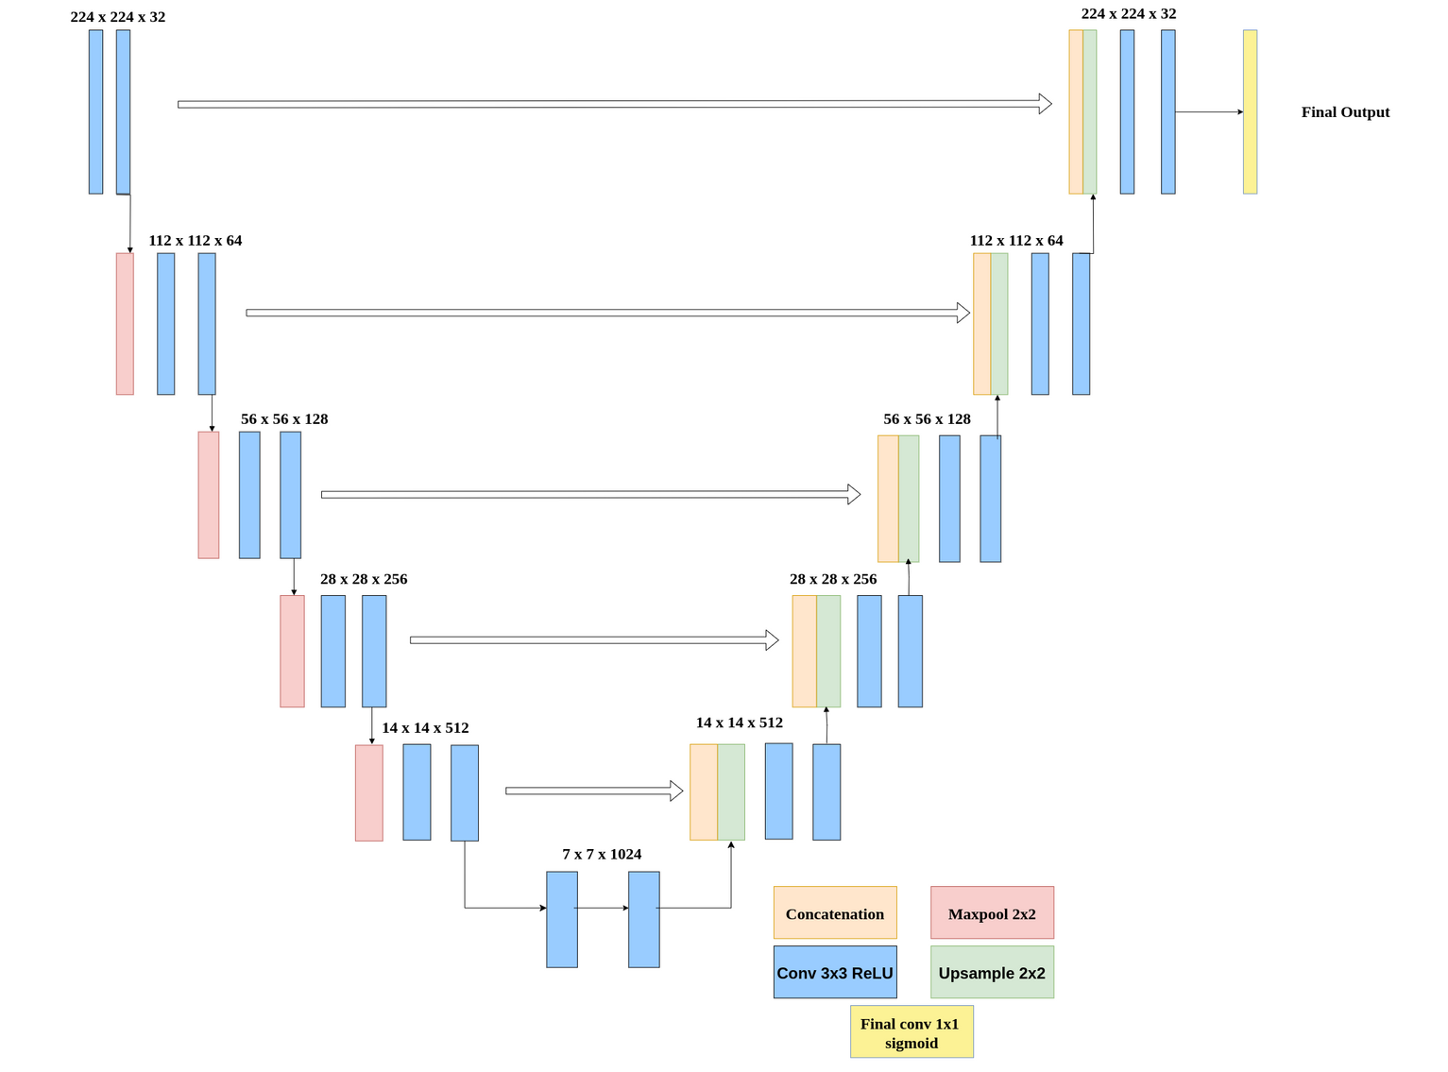
Skin Localization Model Architecture

Slide 33
Training and Testing Metrics for Our U-Net Model
Training Metrics | Training Metrics | Training Metrics | Training Metrics | Training Metrics | Training Metrics
Model Name | Accuracy | Precision | Recall | Dice Coefficient | iou
U-NET | 96.68 | 95.39 | 94.24 | 93.58 | 97.09
Testing Metrics | Testing Metrics | Testing Metrics | Testing Metrics | Testing Metrics | Testing Metrics
Model Name | Accuracy | Precision | Recall | Dice Coefficient | iou
U-NET | 96.14 | 93.44 | 94.09 | 92.55 | 96.43

Slide 34
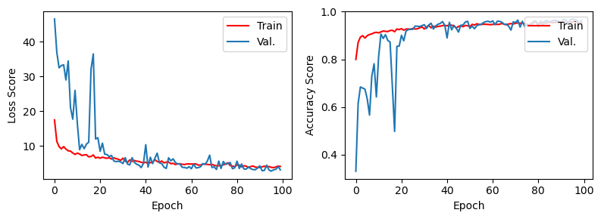
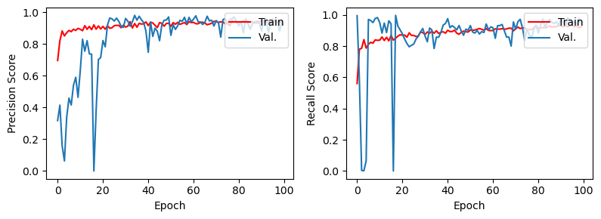
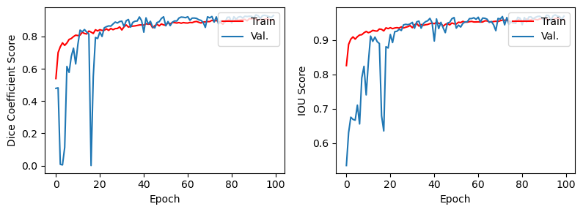
History of performance over the epochs

Slide 35
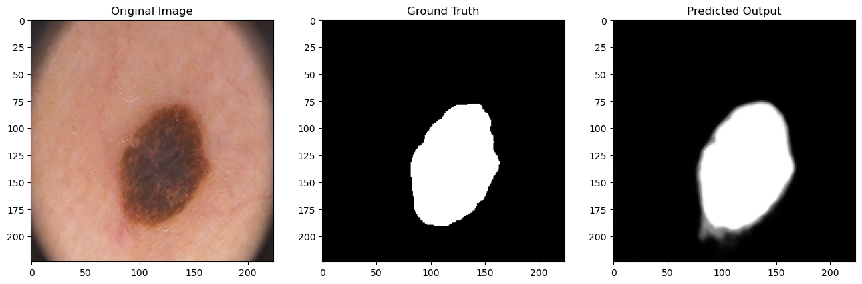
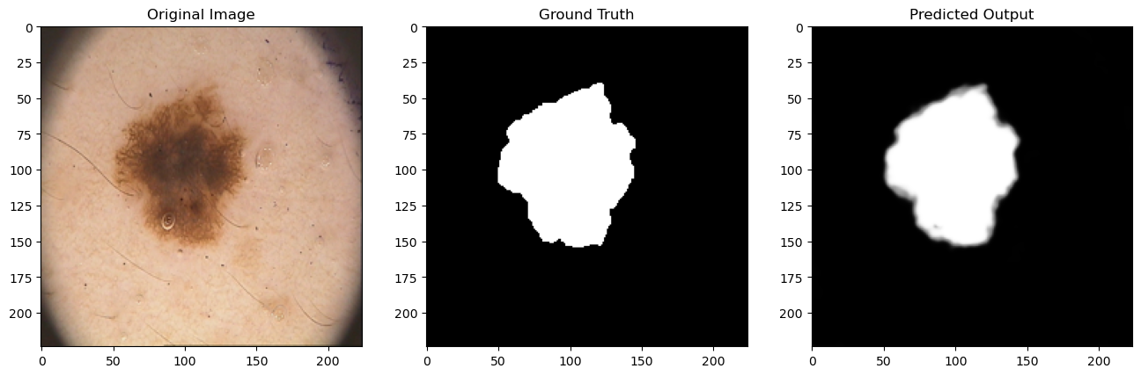
Some of our predictions

Slide 36
Skin
Classification

Slide 37
Methodologies and Techniques for Classification
DATA PREPROCESSING
DATA AUGMENTATION
01
02
01
02
set the image width and height to 28
Data Augmentation
rescaling
Rotation
03
04
03
04
Shifting
Shearing
normalize the data to be from 1 and 0
Make Batch size to 64
05
Flipping

Slide 38
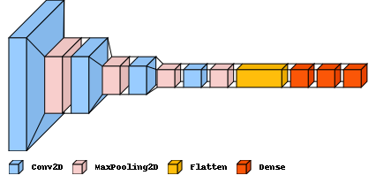
Skin Classification Model Architecture

Slide 39
Training and Testing Metrics for Our Models
Training Metrics | Training Metrics | Training Metrics | Training Metrics
Model Name | Accuracy | Precision | Recall
DeepConvNet | 99.5 | 99.5 | 99.5
Auto Encoder | 70.17 | 82.26 | 58.09
cnn decay lr | 81.23 | 89.72 | 73.28
VGG16 | 67.13 | 84.03 | 54.65
ResNet50 | 66.99 | 66.99 | 66.99
InceptionV3 | 66.97 | 85.86 | 54.2
Xception | 66.8 | 85.92 | 54.31
Testing Metrics | Testing Metrics | Testing Metrics | Testing Metrics
Model Name | Accuracy | Precision | Recall
DeepConvNet | 97.204 | 97.5 | 97.2
Auto Encoder | 70.17 | 82.49 | 58.17
cnn decay lr | 73.64 | 81.1 | 67.9
VGG16 | 66.99 | 83.52 | 60.03
ResNet50 | 66.83 | 66.83 | 66.83
InceptionV3 | 66.89 | 85.19 | 60.58
Xception | 66.73 | 83.29 | 61.04

Slide 40
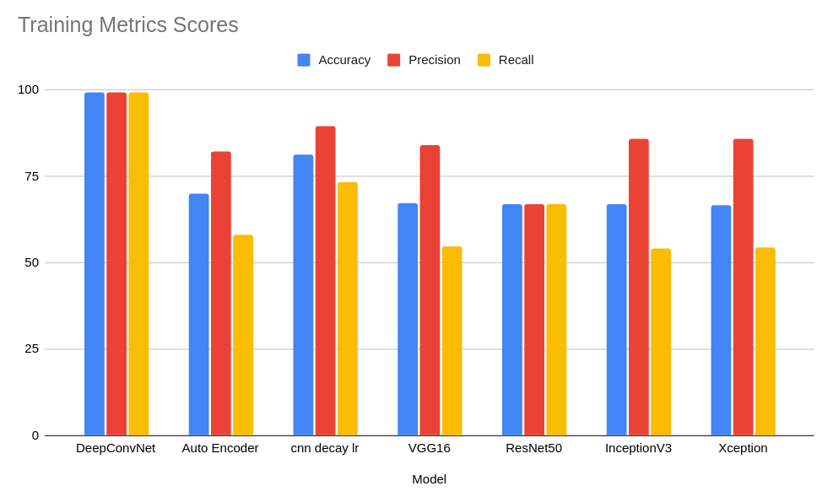
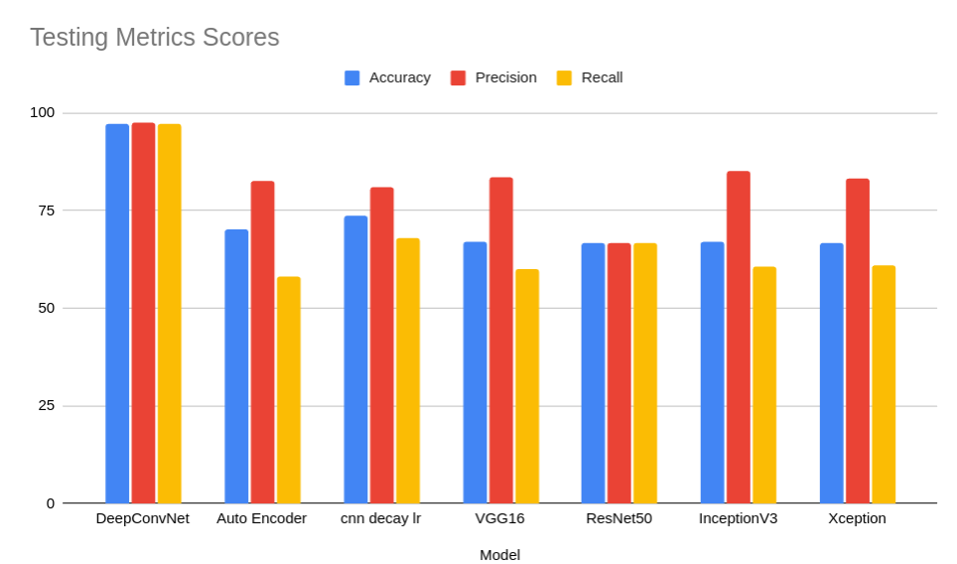
Training and Testing Graphs for Our Models

Slide 41
Training Metrics for Us and Other Papers
Model Name | Accuracy | Precision | Recall
Panda et al. [1] | - | 97 | 95.2
Wang et al. [2] | 84.6 | - | -
Aldhyani et al. [4] | 97.8 | 98.1 | 98
Maqsood and Damaševičius [5] | 98.57 | - | -
Shetty et al. [7] | 91.77 | - | -
Ali et al. [8] | 93.16 | 96.57 | 93.66
Anand et al. [15] | 89.09 | - | -
Alam et al. [16] | 91 | - | -
Aladhadh et al. [19] | 96.14 | 96 | 96.5
RD Seeja & A Suresh [21] | 85.19 | 42.59 | 50
Tajerian et al. [22] | 94 | 88 | 85
Current Proposed Method DeepConvNet | 99.5 | 99.5 | 99.5

Slide 42
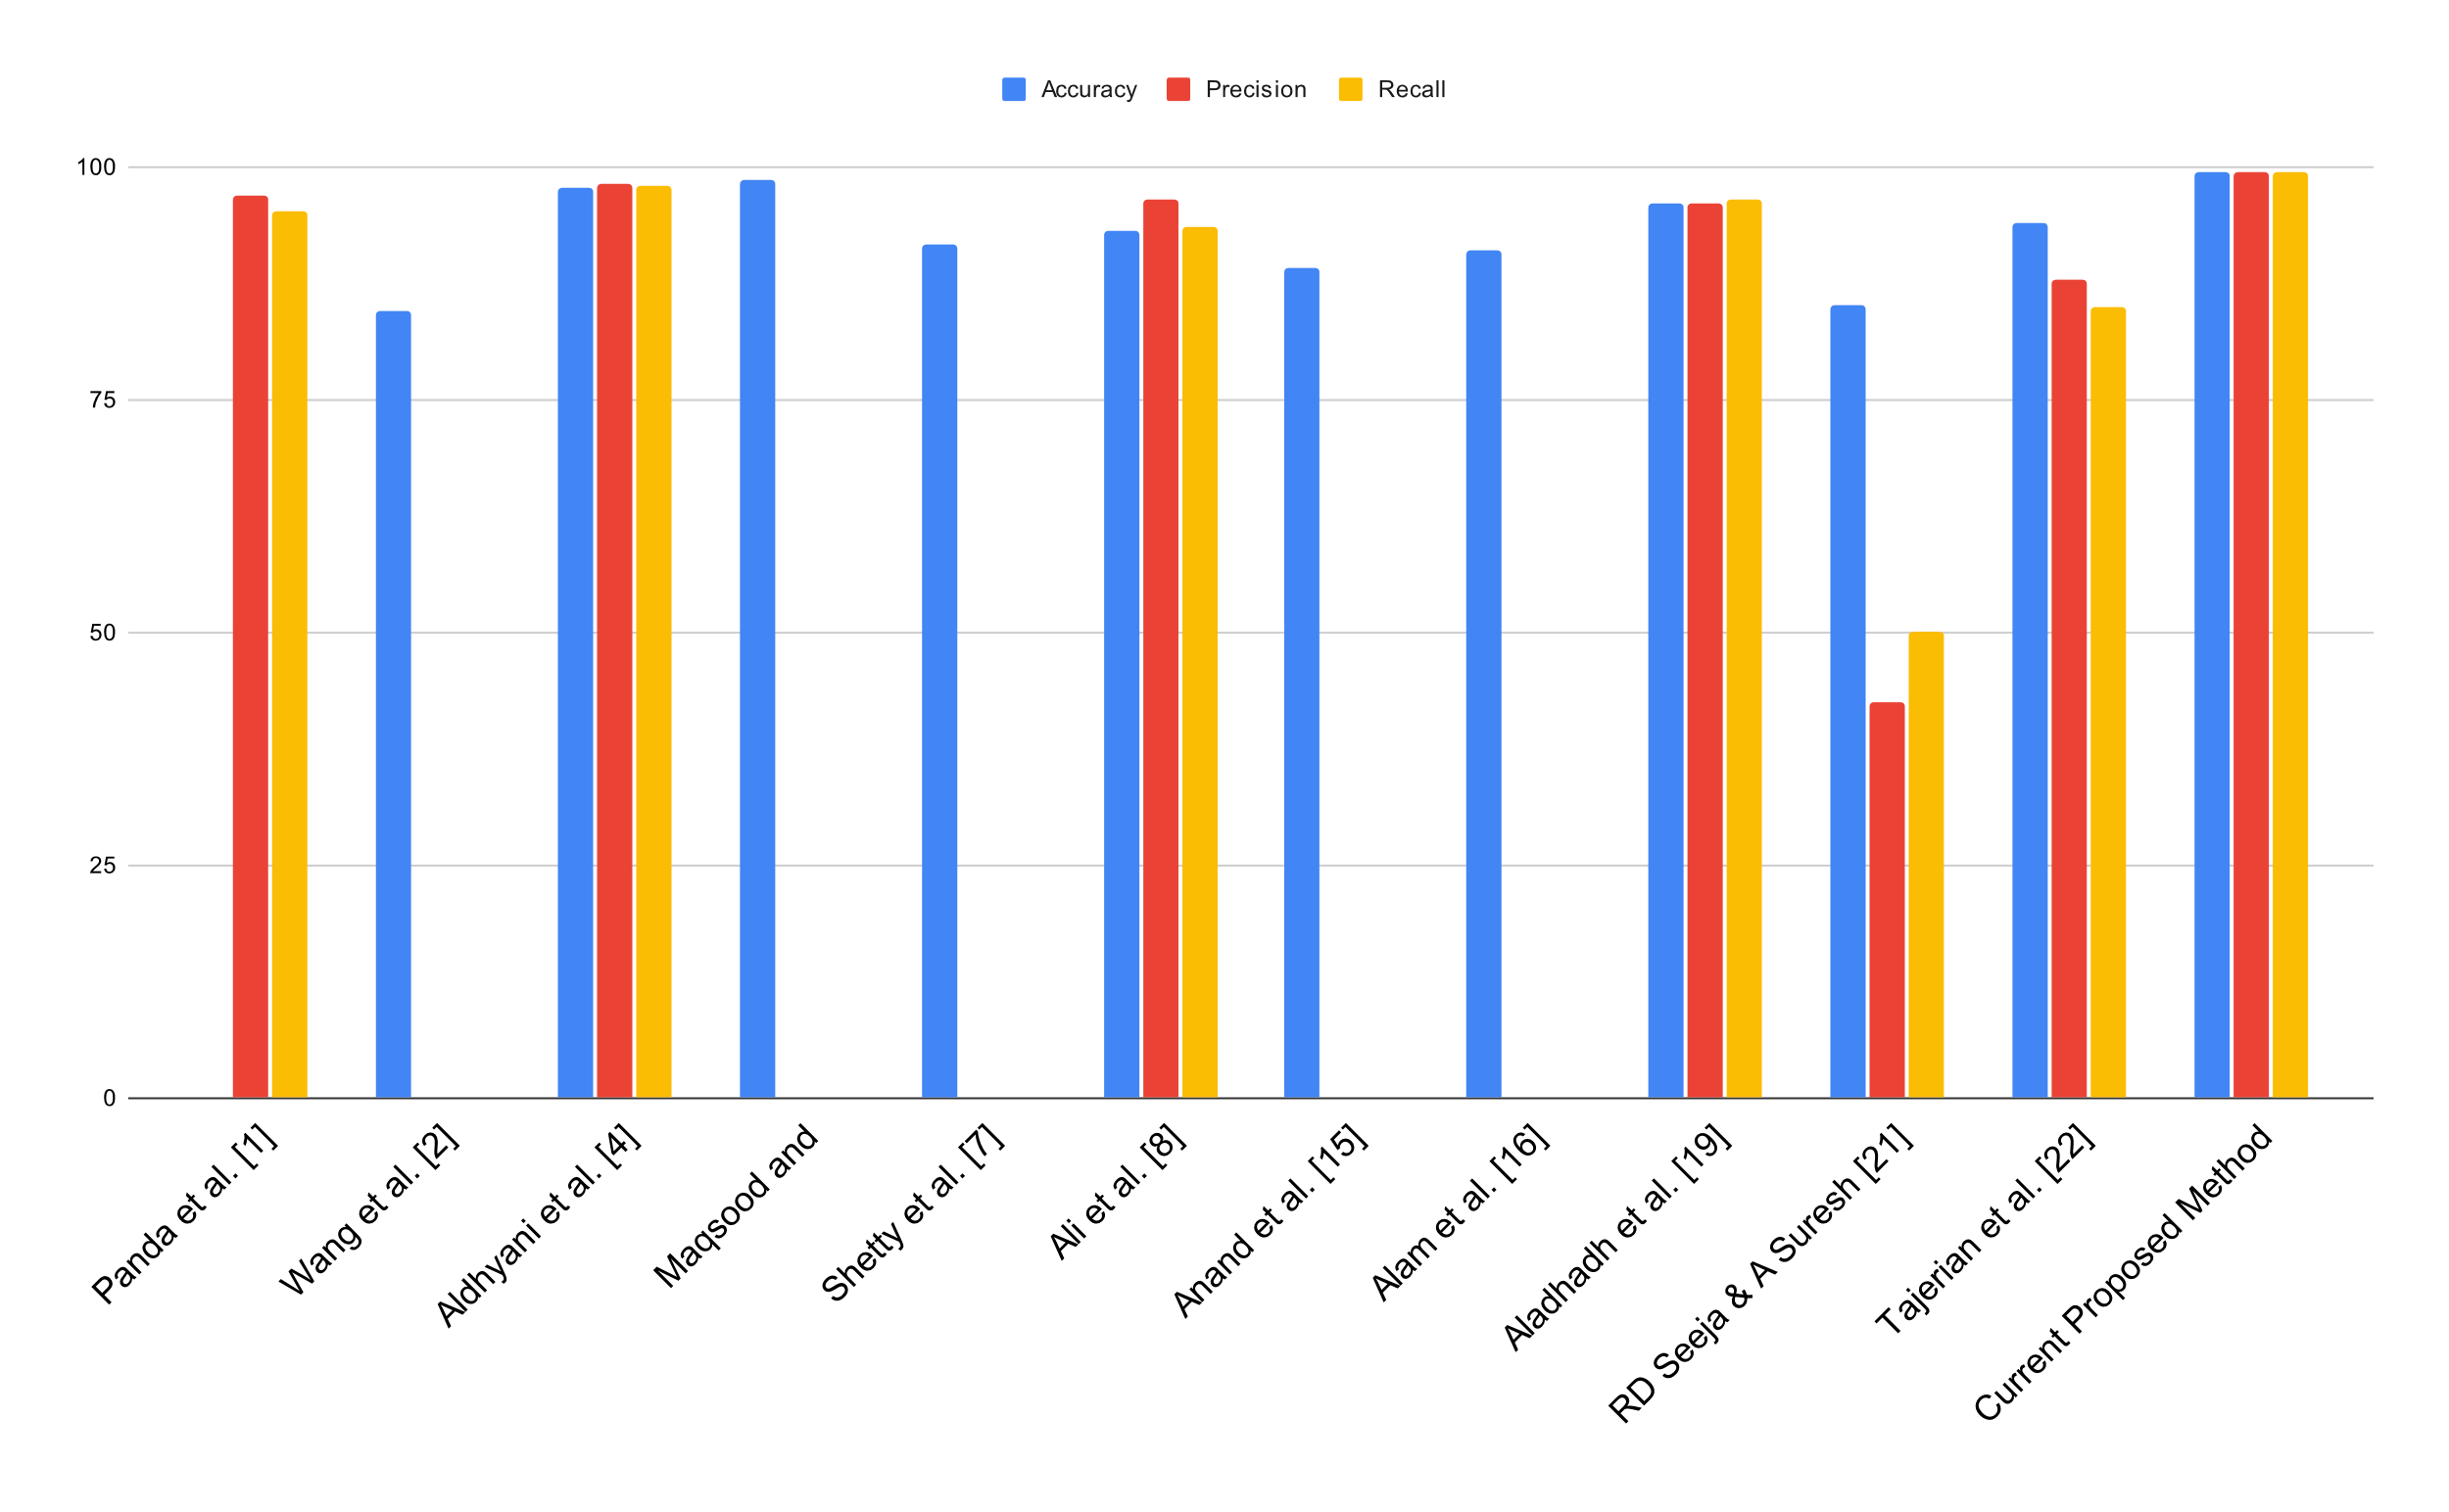
Training Graph for Us and Other Papers

Slide 43
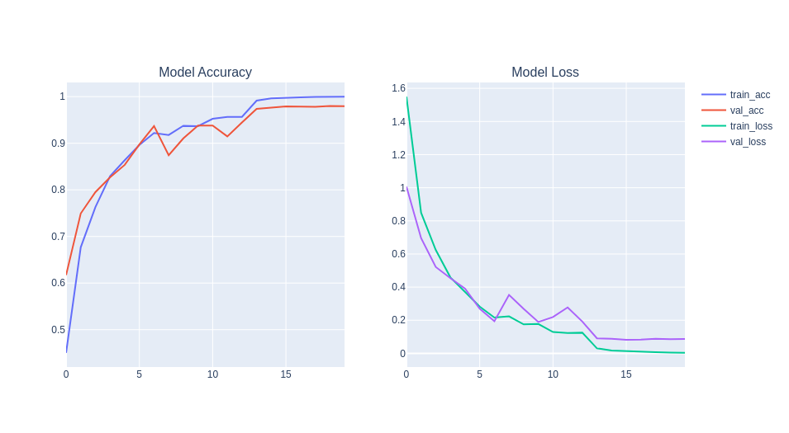
History of performance over the epochs

Slide 44
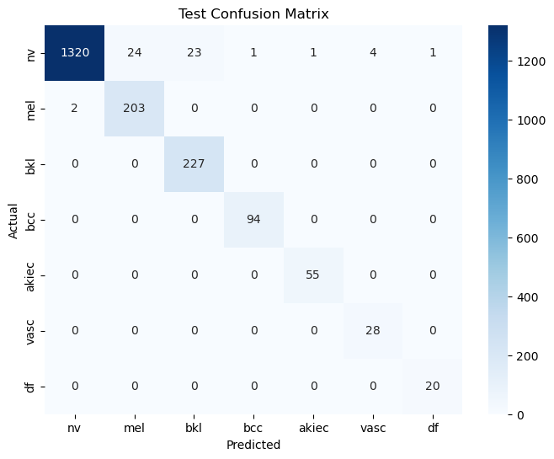
Confusion Matrix

Slide 45
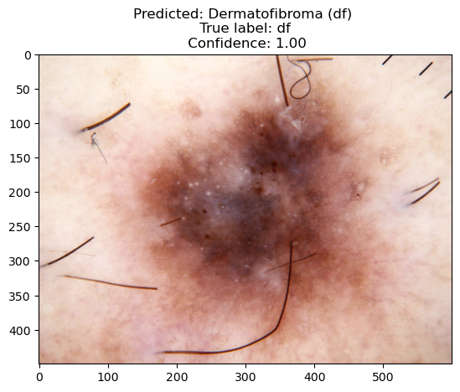
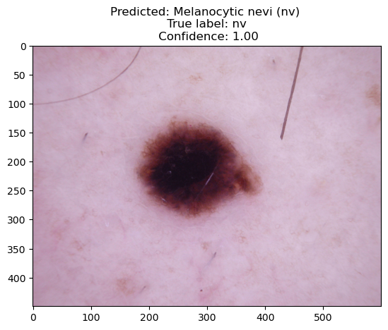
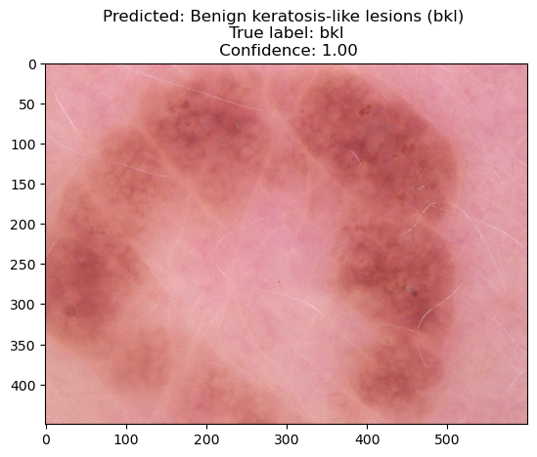
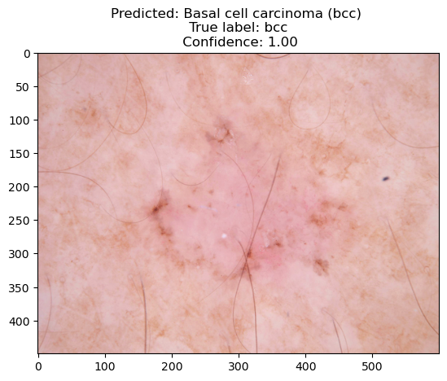
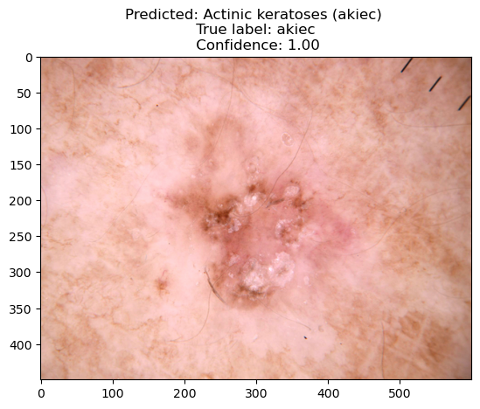
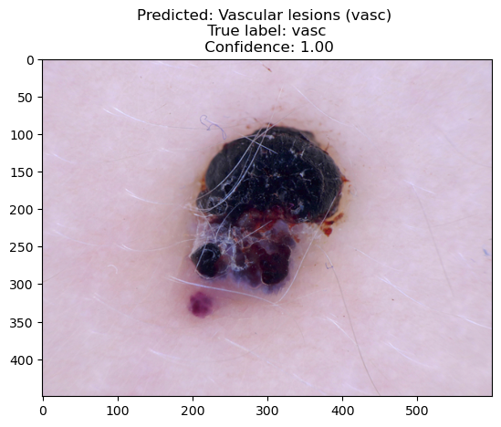
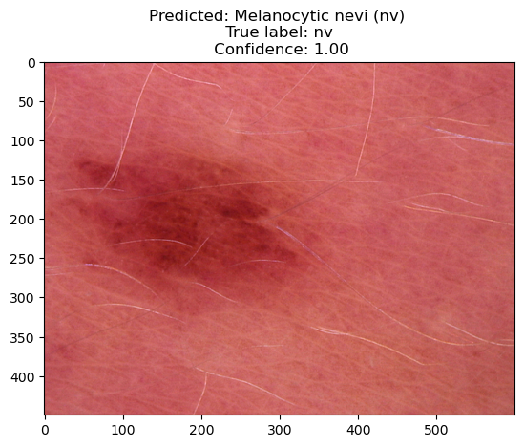
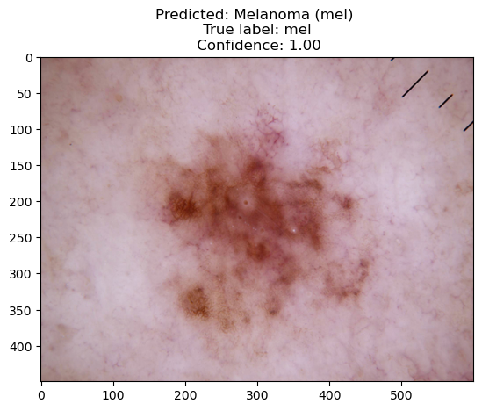
Some of our predictions

Slide 46


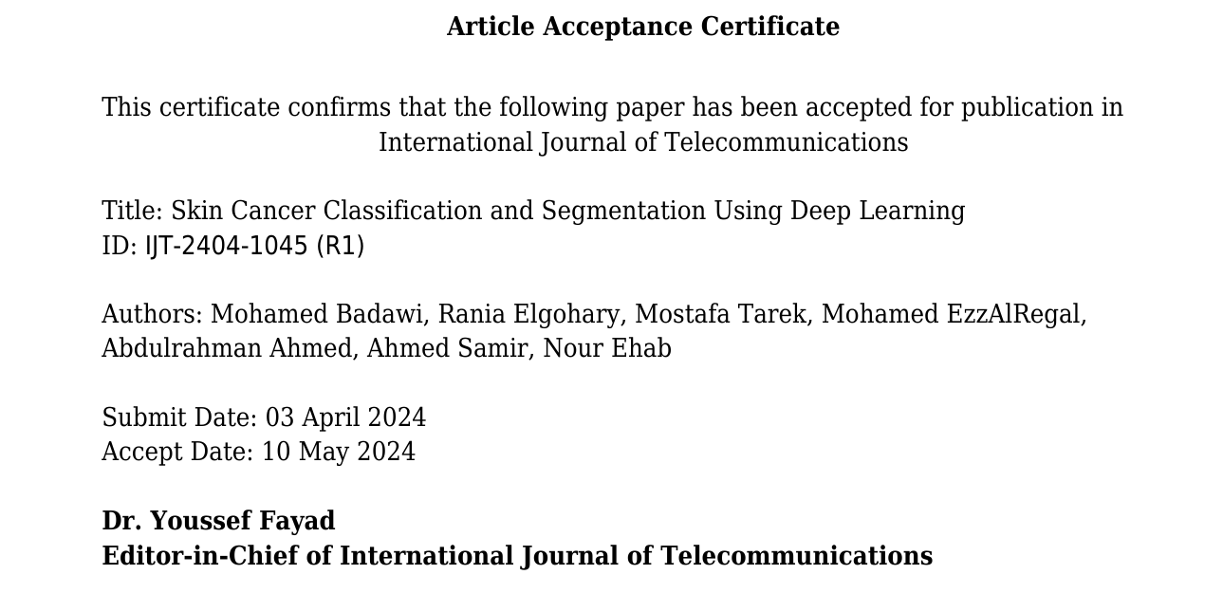
Research Paper
Paper Acceptance Certificate | Paper QR Code

Slide 47












Software Tools
Kaggle
GitHub
HTMl
TensorFlow
Anaconda
CSS
Python
OpenCV
Visual Studio Code
Java Scrip
SQL
Keras

Slide 48
Our
APPlication

Slide 49
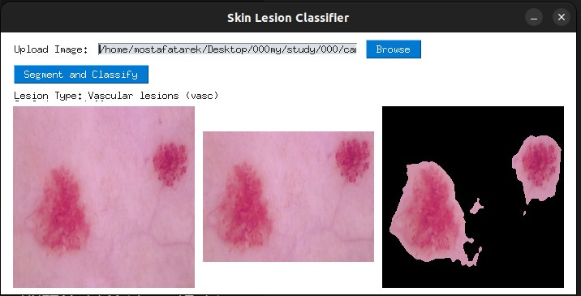
Desktop APP using PySimpleGUI

Slide 50
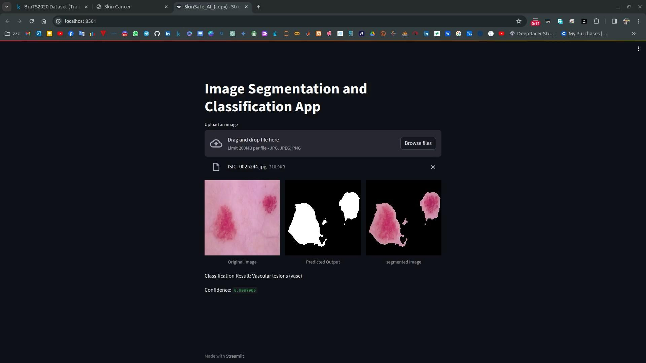
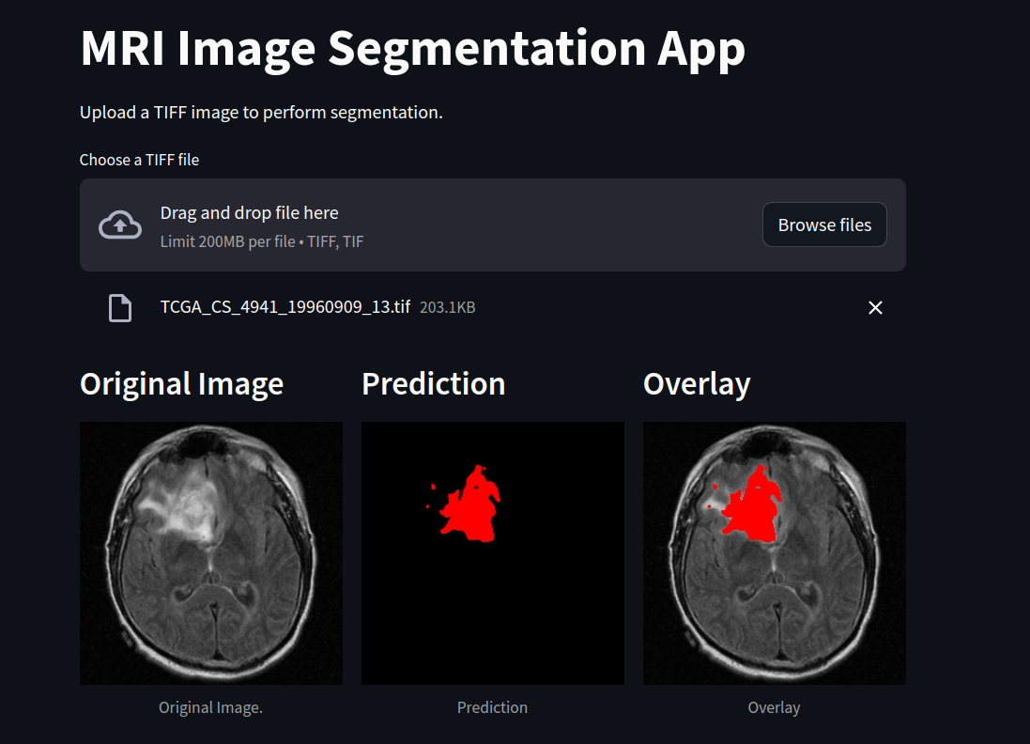
Streamlit APP

Slide 51
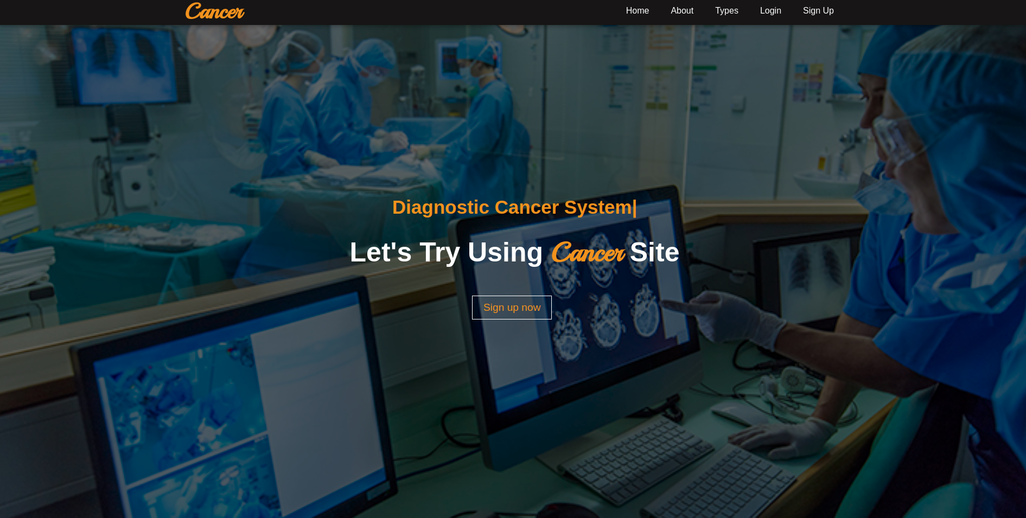
Website Platform

Slide 52
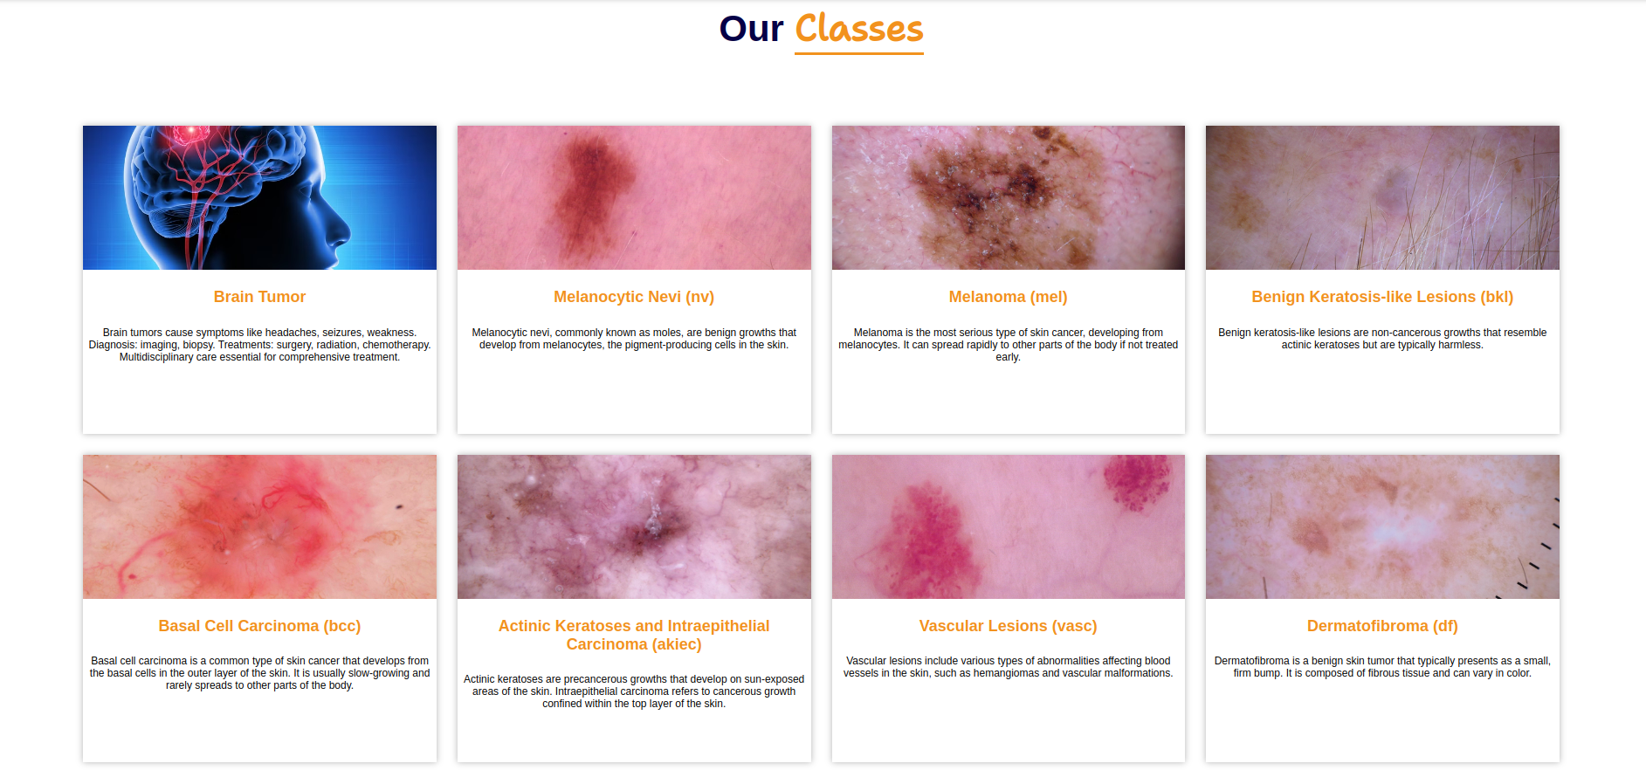
Website Platform (Cont.)

Slide 53
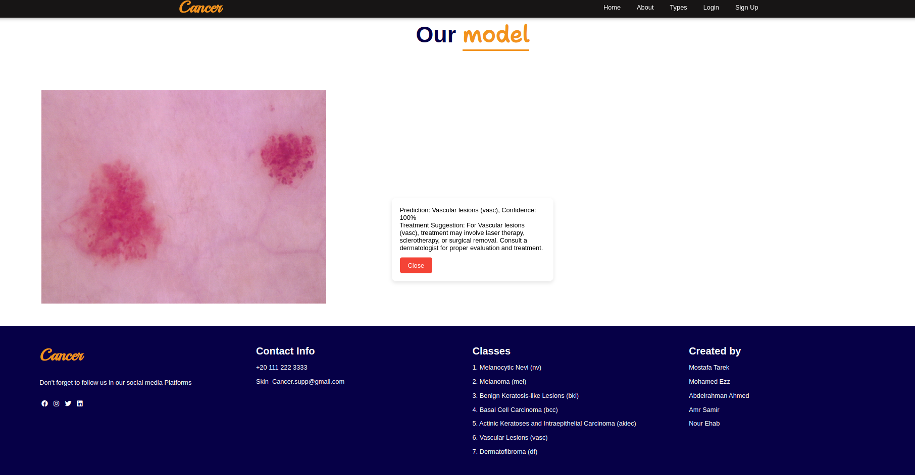
Website Platform (Cont.)

Slide 54
Conclusion
Our project uses cutting-edge medical imaging and machine learning for early and precise cancer detection, aiming to improve healthcare efficiency, alleviate diagnostic challenges, and lessen the psychological and financial burdens on patients globally.
Our project follows a 6 phase plan which allows for a smooth operation: enhancing early diagnostic accuracy, precise lesion segmentation for more informed decisions, streamlined work flow for better efficiency of patient care, will help research and data advancements for future use.

Slide 55
Future Work
Multi-Modal Diagnosis: Extend our AI project to cover multiple imaging modalities beyond skin and brain scans. Incorporating X-rays, CT scans, or histopathological images will facilitate comprehensive cancer diagnosis across various types.
Clinical Decision Support: Integrate our AI project into clinical workflows to offer decision support for healthcare professionals.
Patient Engagement: Foster patient engagement and adherence to treatment plans through personalized health recommendations generated by our AI project.

Slide 56
References
1.Y Wang, Y Wang,J Cai, TK Lee, C Miao, ZJ Wang. Ssd-kd: A self-supervised diverse knowledge distillation method for lightweight skin lesion classification using dermoscopic images. Medical Image Analysis. 2023 Feb 1;84:102693.
2. S Panda, AS Tiwari, MR Prusty. Comparative study on different Deep Learning models for Skin Lesion Classification using transfer learning approach. International Journal of Scientific and Research Publications. 2021;11(1):219-32.
3. Wang B, Geng P, Li T, Yang Y, Tian X, Zhang G, Zhang X. A deep model towards accurate boundary location and strong generalization for medical image segmentation. Biomedical Signal Processing and Control. 2024 Feb 1;88:105623.

Slide 57

Notes:
5

